Slide 1
MOBILE HOLDER
Aparna A Patil
Kruthika H.S
Mahi Naresh Hegde
Supreetha Vikram

Slide 2


Agenda
A
Introduction
Literature Survey
Methodology
Fabrications
Prototype
Reference

Slide 3
Introduction
A study by the university of Texas at Austin found that smart phones demand our attention even when they are not in use. People are always thinking about their phones which means mobile accessories will attract their attention so we chose mobile holder project. Even if there are different accessories for phones. Mobile holder are the real winners. A stand keeps you organized and gives your hand a break. It can do a lot for your phones safety it will prevent your phone from damage cause due to various reasons. Mobile phone holders are easy to use and they give a lot of comfort to the users helping them to focus in their work. Phone stands are small objects that are used to prop up your device.
.

Slide 4
They are designed to sit on a hard surface like a table or desk so you can watch funny videos, scroll through pics an ultimately keep your phone clean and safe. It can do a lot for your phone’s safety and cleanliness and even more for your comfort and productivity.
There are instances when you need to keep your phone in place, but it may not be your pocket or backpack. This is where the phone stand comes in!! It allows you to place your device anywhere at any angel and it is a very comfortable experience. The phone stand provides a more stable and comfortable place to hold your phone and makes it easier to do more with it. In today’s technologically advanced world, most of us rely on our phones for everything from entertainment to work. A mobile holder can simplify task such as video conferencing with loved once or browsing at work.

Slide 5
These items are designed to prop up your mobile device so you can watch videos and enjoy and keep it clean, think of them as small objects that sit on hard surface like table or desk. The popularity of smart phones has leads to development of mobile holders and phone stands that can be used in car, home, at work and even in the grocery line.
If you have a reliable phone stand you can enjoy relaxing movements even if you watch a video or a movie on your phone. A smart phone typically weighs about 0.3pounds so that we can enjoy pleasant relaxation on your arms and neck!! Mobile holders provide a steady support which makes our work even more easy as we can completely concentrate on our work. Let us free our hands and use phone anywhere without holding it.

Slide 6
Literature Survey

Slide 7
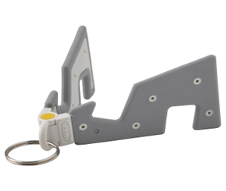
1. Yuppienalle holder
Manufacturer: Giant shopping
Origin: China
Cost: INR 185
Features:
Made of durable material, it withstands all your travels.
There are two slots which allow you to position the phone vertically or horizontally.
Advantage: Great handy product for keeping mobiles and viewing.
Disadvantage:
1.Doesn’t handle weights of heavier phones.
2.quality is ok but the stability of the product should be increased

Slide 8
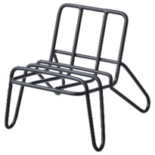
2. Krubbet holder
Manufacturer: IKEA
Origin: Sweden
Cost: INR 149
Features:
This mobile holder can be set in three different positions and you can charge at the same time, it can be used in damp places
Advantage: Aesthetic and utilitarian
Disadvantage: Need some grip / base to be having rubber coating

Slide 9
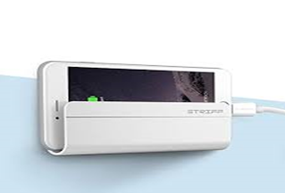
3. Wall mount holder
Manufacturer: ASTEE TRADING
Origin: India
Cost: INR 199
Features:
Advanced reusable adhesive: repositionable, washable adhesive sticks to most cases, won't stick to silicone/highly textured cases. Packaging includes adhesive disc & mount stand to apply directly to iPhone & other glass back phones.
Advantage: Built with high-grade & recyclable plastics: to make it durable, longer lasting and good toughness. Rubber pads and feet protect your device from scratches and sliding.
Disadvantage: not convenient for viewing.

Slide 10
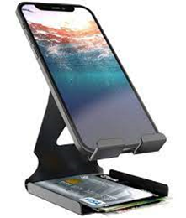
4. Nbox holder
Manufacturer: Mobile enhancer
Origin: India
Cost: INR 499
Features:
Lightweight and portable 7 feet holder
Advantages: Portable.
Disadvantages: Not suitable for small phones.

Slide 11
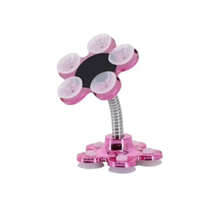
5. Maxbell holder
Manufacturer: Aladdin shoppers
Origin: India
Cost: INR 78
Features:
360° Rotating Design With a single click, the mobile phone can be firmly adsorbed and operated easily and quickly by one hand,360-degree freely adjustable magic mobile phone holder. Creative Stable Design Adopt to unique flower design with each petal having a small sucker, pretty appearance and support phone more firmly. You can place the stand on any flat surface.
Advantage- Rotates 360°.
Disadvantage- Spring mechanism is slightly not suitable.
The adhesiveness of this product is limited.

Slide 12
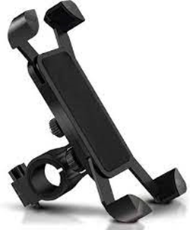
6. Skycell holder
Manufacturer: SKYCELL
Origin: India
Cost: INR 375
Features:
Hands free, ergonomically designed keeping the golden ratio view in mind.
Free Lift, Retractable height freedom, the max height 14.37 inches, maximum shrinkage width 10.43 inches for clamping the phone.
Has ABS telescopic rod and frosted texture
Advantage: Multiangle adjustment.
Disadvantage: Neck arm fatigue needs improvement for tensile strength.

Slide 13
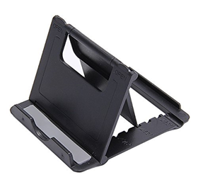
7. SDO holder
Manufacturer: Tabletop
Origin: India
Cost: INR 270
Features:
Support your device in both portrait and landscape mode
Angle adjustable and multifunctional for viewing, gaming or typing
Simply and easily to use and easily pack away when not in use. Compatible with: Apple I-pad I-phone Samsung Sony HTC Xiaomi Le tv Huawei Lg Lenovo One plus Moto and All Mobile Phone
Advantage: Support your device in both portait and landscape mode. Easy to use and easy pack away when not in use.
Disadvantage: Less Stability and Sturdiness.

Slide 14
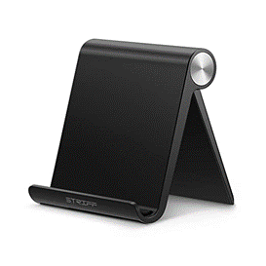
8. Striff Ps2 mobile holder
Manufacturer: STRIFF
Origin: China
Cost: INR 119
Features:
98mm*96mm*19mm, STRIFF desk phone stand is foldable and easy to slip into your pocket suitable for bed, table and home
Directly adjust to your preferred angle among 10 different viewing angles, from 0° to 100°.Hold your smartphone or mini tablet in portrait or landscape mode safe.
Hold your smartphone or mini tablet at a comfortable angle, ideal for watching video, reading, video recording or simply browsing the web, playing games, facetime and other handsfree operation at home, office and travel
Advantage: wide range of compatibility.
Multiangle adjustable, portable and reliable
Disadvantage: Made of silicon so not flexible.
No option to charge.

Slide 15
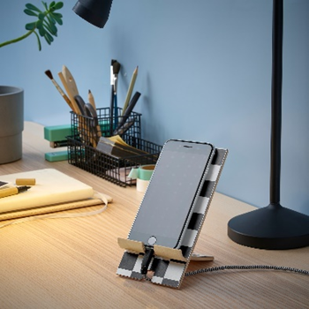
Pluggland holder
Manufacturer: IKEA
Origin: China
Cost: INR 765
Features:
This holder is smart to use when you surf, chat and have virtual.
Advantages: Charging of phone is easy and it helps in multitasking.
Disadvantage: Rigid so can’t rotate.

Slide 16
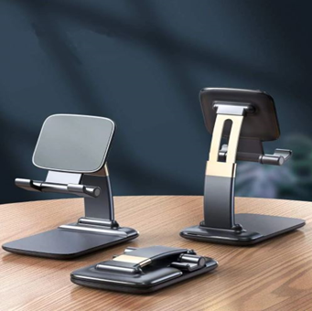
10. Gravity design
Manufacturer: India Mart
Origin: India
Cost: INR 299
Features:
Non-slip & Stable: This desktop cell phone stand equipped with a heavier base and an aluminium alloy rod, which has strong bearing capacity, it's stable enough to support your mobile phone or even iPad.
Adjustable Phone Stand: Shahn phone stand holder for desk is based on ergonomic design, the angles and height can be adjusted to provide you comfortable viewing angle for online class which helps to fix your posture and reduce neck & back strain.
Advantage: Adjustable height and charger.
Fully foldable holder.
Disadvantage: Made of silicon so not rotatable

Slide 17
Summary
With this survey we got to know several advantages and disadvantages of the mobile holder products which are currently available in market. We have got a clear-cut idea on how to design our product according to the user requirements. We have also found out that Silicon material is not compatible for the manufacture of mobile phone holders. We have understood the science and technology used behind each and every product mentioned above. It has enhanced our thinking skills. We interacted with 10 to 15 retailers, consumers and got to know their needs and improvements required in the products. This report helped us in recognizing the necessity of phone holders in global market and their production, revenue and market share for each manufacture.

Slide 18
Business opportunities are like buses. There's always another one coming.
“
”
Richard Branson

Slide 19
Motivation
After the literature survey we were motivated to create a user-friendly product. The following features are as follow:
Free Your hands: view your phone anywhere without holding it with your hands. Having it just makes life better.
Universal Phone Stand - it will be compatible with all size of phones from 2.2 inches (minimum) to 3.34 inches (maximum) in width.
Secure clips to hold the phone in perfect position.
Simple set up, Sturdy foundation, easy rotation and shock resistant.
Its compactness and portability. The phone should be placed in a strong position.
a unique open and close mechanism which will resist abrasion of the clamp.

Slide 20
Objective
To design a mobile phone holder which is convenient for the consumers to use on study tables.
To create a 2D/3D model.
To create prototype and check its functionality.

Slide 21
Methodology
Process to find dimensions :
We used Pythagoras theorem to find the dimensions of our product.
We took,
Thickness=1cm
Width=7cm
Base=a=20cm
Length=b=12cm
Hypotenuse=c=23.32cm, a2+b2 = c2 using this formula we found the length of the hypotenuse.

Slide 22
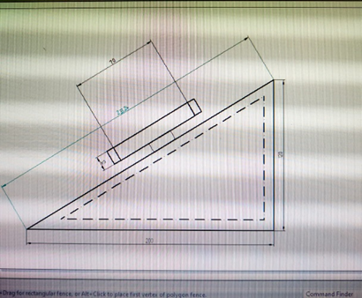
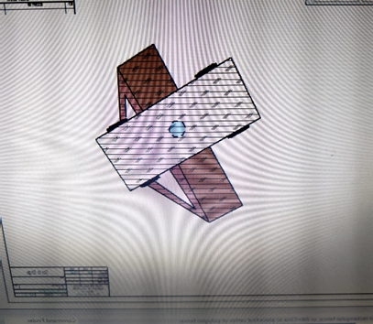
App used is solid edge 14 for 2D and 3D

Slide 23
Material :
Pine wood was preferred by our team members due to its durability and its advantageous properties. It is easy to shape and it has light weight which makes it easy for consumers to carry it around. Pine wood is easy to paste which helps in creating efficient design. It is easy to nail and screw. Although logically there are important differences depending on the species and where we buy it, the price of pinewood is low. Especially if we compare it with other wood. It is mainly due to its abundance. Cost of pine wood per square meter is inexpensive.

Slide 24
Design :
We wanted to design something compact, portable and unique. A triangular base is taken and the clamp is fixed onto its hypotenuse. The clamp is rotatable and adjustable according to the width of the phone used by the consumer. We used wood for extra stability and strength. With the dimensions we found using Pythagoras theorem we designed our product by interacting with carpenter. There is a compartment present below the clamps which helps in storing electronic devices like ear phones, ear pods etc. The height of the stand is adjustable so that the user can look at his phone from different angles.

Slide 25
Fabrication
Our product is made of pine wood. Pine wood is light and durable, it is long lasting compared to other products like silicon, steel etc. Clamp is made of plastic in order to protect the phone from damage.

Slide 26
Prototype
P

Slide 27
How we got there(Reference)
Yuppienalle holder
https://www.ikea.com/in/en/p/yuppienalle-holder-for-mobile-phone-grey-60503885/?gclid=Cj0KCQiAgribBhDkARIsAASA5bv567lw0_e7mQalGCJyAIUfVSKQ_ERZrtsvjH9QQifsCA4l0RsPufIaAmtEEALw_wcB
Krubbet holder
https://www.ikea.com/in/en/p/krubbet-holder-for-mobile-phone-black-70531939/
ASTEE TRADING Wall mount holder
https://www.snapdeal.com/product/mobile-phone-holder-stand-wall/6917529650202099471

Slide 28
Nbox holder
https://lowpricesaree.in/product/nbox-universal-mobile-phone-stand-holder-mount-with-inbuilt-cable-organiser-for-phones-and-tablet-upto-17-78-cm-7-inch-black-earphone-not/
Maxbell holder
https://aladdinshoppers.com/products/0637a_tiktok_vip_stand?variant=42205590913205&currency=INR&utm_medium=product_sync&utm_source=google&utm_content=sag_organic&utm_campaign=sag_organic
Skycell holder
https://www.flipkart.com/skycell-bike-mobile-holder-stand-phone-mount-push-button/p/itm1f51509f9af7b
SDO holder
https://arcus-www.amazon.in/SDO-Universal-Portable-Foldable-Holder/dp/B01CEZH9N4

Slide 29
Striff Ps2 mobile holder
https://www.amazon.in/STRIFF-Mobile-Android-Samsung-OnePlus/dp/B07GXHC691
Pluggland holder
https://www.ikea.com/in/en/p/pluggland-holder-for-mobile-phone-check-pattern-black-white-90518828/
Gravity design
https://mycookwareshop.com/products/copy-of-bike-mobile-universal-bike-cell-phone-spider-bike-multi-use-mobile-holder-x-grip-motorcycle-handlebar-mount-smartphone-holder-black-1?_pos=10&_sid=beebc680f&_ss=r

Slide 30
Timeline
Deploy strategic networks with compelling e-business needs
Oct 27, 2022
Decided the topic of making all rounder Mobile holder
Nov 20XX
Disseminate standardized metrics
Jan 20XX
Coordinate e-business applications
Mar 20XX
Foster holistically superior methodologies
May 20XX

Slide 31
Thank you
Mirjam Nilsson​
mirjam@contoso.com
www.contoso.com

